Slide 1





State Management
Cookies and Sessions
State Management
SoftUni Team
Technical Trainers
Software University
http://softuni.bg

Slide 2





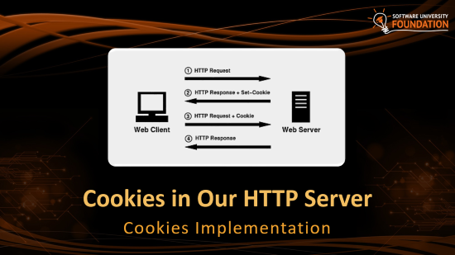


Table of Contents

Slide 3
Have a Question?
sli.do #CSharp-Web

Slide 4

HTTP Cookies
Usages and Control

Slide 5


What are Cookies?
A small file of plain text with no executable code
Sent by the server to the client's browser
Stored by the browser on the client's device (computer, tablet, etc.)
Hold small piece of data for a particular client and a web site

Slide 6
Why are Cookies Used?
Session management
Logins, shopping carts, game scores, or anything else the server should remember
Personalization
User preferences, themes, and other custom settings
Tracking
Recording and analyzing user behavior

Slide 7


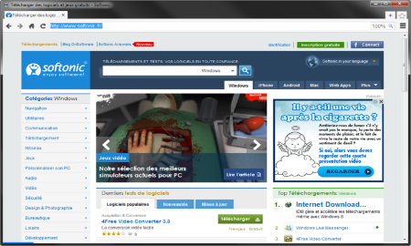



Session Management
The HTTP object is stateless
it doesn’t store information about the requests
Web Client
Web Application
GET
POST
GET
Not stored

Slide 8
Stateless HTTP – the Problem
The server does not know if two requests come from the same client
State management problems
Navigation through pages requires authentication each time
Information about the pages is lost between the requests
Harder personalization of functionality of pages

Slide 9
Stateless HTTP – the Cookie Solution
A reliable mechanism for websites to remember stateful information
to know whether the user is logged in or not
to know which account the user is logged in with
to record the user's browsing activity
to remember pieces of information previously entered into form fields (usernames, passwords, etc.)

Slide 10
How are Cookies Used?
The response holds the cookies to be saved within the Set-Cookie header
The request holds the specific web site cookie within the Cookie header
HTTP/1.1 200 OK
Set-Cookie: lang=en
GET www.example.bg HTTP/1.1
Cookie: lang=en

Slide 11
Server-Client Cookies Exchange
http://www.example.bg/
Web Client
GET www.example.bg HTTP/1.1
Web Application
HTTP/1.1 200 OK Set-Cookie: lang=en
GET www.example.bg HTTP/1.1
Cookie: lang=en

Slide 12
Cookie Structure
The cookie consists of Name, Value and Attributes (optional)
The attributes are key-value pairs with additional information
Attributes are not included in the requests
Attributes are used by the client to control the cookies
Name=Value
Attributes
Set-Cookie: SSID=Ap4P…GTEq; Domain=foo.com; Path=/; Expires=Wed, 13 Jan 2021 22:23:01 GMT; Secure; HttpOnly

Slide 13
Scope
Defined by the attributes Domain and Path
Domain – defines the website that the cookie belongs to
Path – Indicates a URL path that must exist in the requested resource before sending the Cookie header
Set-Cookie: SSID=Ap4P…GTEq; Domain=foo.com; Path=/; Expires=Wed, 13 Jan 2021 22:23:01 GMT; Secure; HttpOnly

Slide 14
Lifetime
Defined by the attributes Expires and Max-Age
Expires – defines the date the browser should delete the cookie
By default the cookies are deleted after the end of the session
Max-Age – interval of seconds before the cookie is deleted
Set-Cookie: SSID=Ap4P…GTEq; Domain=foo.com; Path=/; Expires=Wed, 13 Jan 2021 22:23:01 GMT; Secure; HttpOnly

Slide 15
Security
Security flags do not have associated values
Security - tells the browser to use cookies only via secure/encrypted connections
HttpOnly – defines that the cookie cannot be accessed via client-side scripting languages
Set-Cookie: SSID=Ap4P…GTEq; Domain=foo.com; Path=/; Expires=Wed, 13 Jan 2021 22:23:01 GMT; Secure; HttpOnly

Slide 16
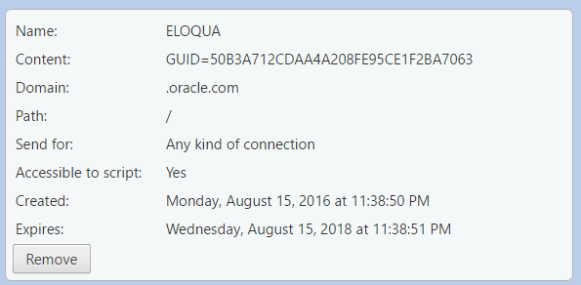
What is in the Cookie?
The cookie file contains a table with key-value pairs

Slide 17
Examine Your Cookies
Most cookies are stored in a RDBMS, usually SQLite
Download SQLite browser from here
Location of Mozilla cookies
Location of Chrome cookies
C:\Users\{username}\AppData\Roaming\Mozilla\Firefox\Profiles\{name}.default\cookies.sqlite
C:\Users\{username}\AppData\Local\Google\Chrome\User Data\Default\Cookies

Slide 18
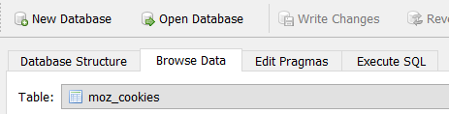
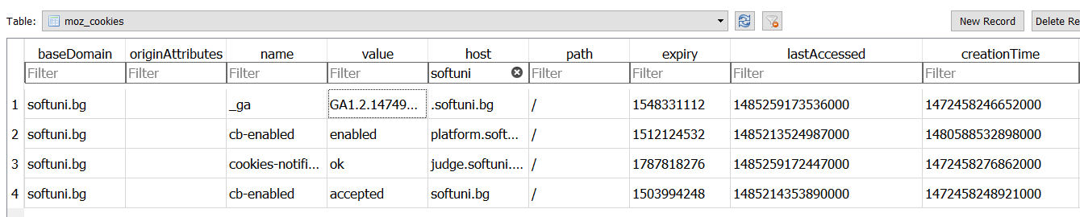
Examine Your Cookies (2)
Open the file with the sqlite browser
Browse the cookies table
Name
Host
Expiration date
Created on
Value
Paths
Last accessed on

Slide 19
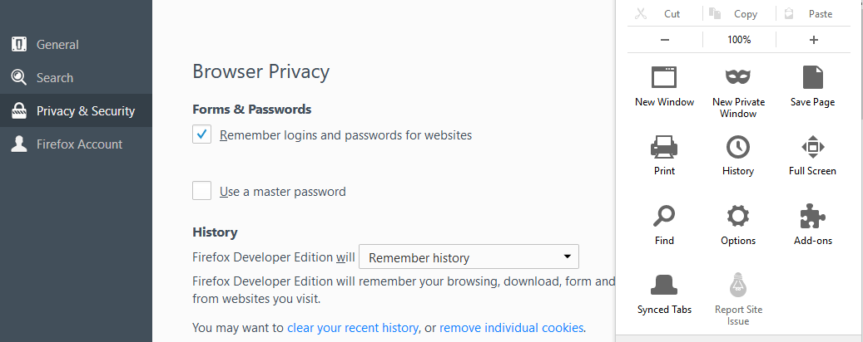
Control Your Cookies – Mozilla Browser

Slide 20
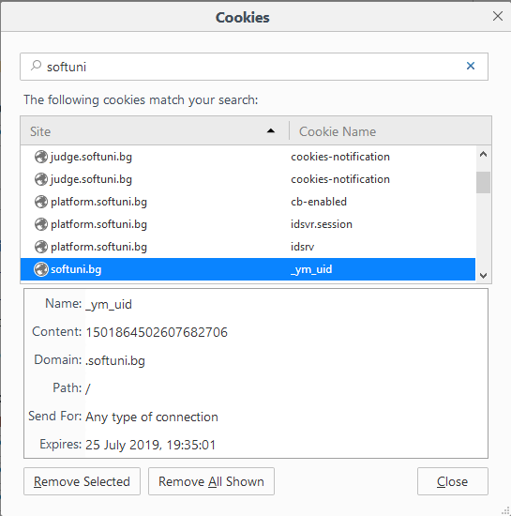
Control Your Cookies – Mozilla Browser (2)
Browse cookies from a selected website
Delete a particular cookie or all cookies

Slide 21
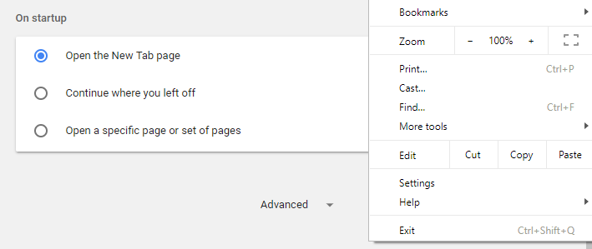


Control Your Cookies – Chrome Browser

Slide 22

Third Party Cookies
Cookies stored by an external party (different domain)
http://stackoverflow.com/
Web Application
Web Client
Cookie transfer
Cookie transfer
Third Party

Slide 23
Third Party Cookies
Cookies stored by an external party (different domain)
Mainly used for advertising and tracking across the web
http://stackoverflow.com/
Web Client
Web Application
Cookie transfer
Cookie transfer
Third Party

Slide 24
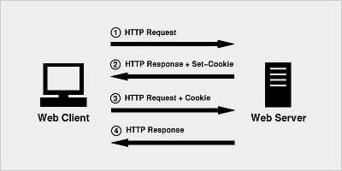
Cookies in Our HTTP Server
Cookies Implementation

Slide 25
The Cookie Class - Properties
public string Key { get; }
public string Value { get; }
public DateTime Expires { get; }
public bool IsNew { get; } = true;
public override string ToString()
{ //TODO: Implement method }

Slide 26
The Cookie Class - Constructors
public HttpCookie(
string key, string value, int expires = 3)
{
//TODO
}
public HttpCookie(string key, string value, bool isNew, int expires = 3) : this(key, value, expires)
{
//TODO
}

Slide 27
Changes in the HttpHeaderCollection
The change allows us to keep several headers with same key
Change the code of the server in order to work with the new implementation of HttpHeaderCollection class
private readonly Dictionary<string, HttpHeader> headers;
private readonly Dictionary<string, List<HttpHeader>> headers;

Slide 28
Parse Cookies in the HttpRequest
private void ParseCookies()
{
if (this.HeaderCollection.ContainsKey("Cookie")
{
List<HttpHeader> cookiesList =
this.HeaderCollection.GetHeader("Cookie");
foreach (HttpHeader header in cookiesList)
//Code continues on the next slide
}
}

Slide 29
Parse Cookies in the HttpRequest (2)
string cookieString = header.Value;
if (string.IsNullOrEmpty(cookieString)) return;
string[] cookies = cookieString.Split(';');
foreach (string c in cookies)
{
if (!c.Contains("=")) continue;
//TODO: Get cookie key and value
HttpCookie cookie = new HttpCookie(key, value, false);
this.CookieCollection.AddCookie(cookie);
}

Slide 30
Set Cookies in the RequestHandler
private void SetCookies(
IHttpContext httpContext, IHttpResponse httpResponse)
{
var cookies = httpContext.Request.CookieCollection;
foreach (HttpCookie cookie in cookies)
if (cookie.IsNew)
{
httpResponse.AddHeader("Set-Cookie",
cookie.ToString());
}
}

Slide 31

HTTP Sessions

Slide 32

What are Sessions?
A way to store information about a user to be used across multiple pages
/login
Web Application
Session
/home
user: Teo
/products

Slide 33
Session Management
The exchange mechanism be used between the user and the web application
First Time Login
Web Client
Web Application
User credentials
Session ID
33

Slide 34
Session Management
The exchange mechanism be used between the user and the web application
Browsing Pages
Web Client
Web Application
Session ID
Requested data + Session ID
34

Slide 35
Session Management
The exchange mechanism be used between the user and the web application
Browsing pages after
the server is restarted
Web Client
Web Application
Session ID
Requested Data + Session ID
35

Slide 36
Relation with Cookies
Session Store
sid 5 { uid: 101 }
sid 7 { uid: 102 }
Cookie {
name: sid value: 5
}
Validate
Req
Web Application
Session
Resp
Database
Cookie {
name: sid value: 7
}
Req
Get data
uid name 101 Teo
102 Bojo
Resp
Create personal web page

Slide 37
Session Structure
"hje85d3" : {
user_id: 789
username: FirstUser
},
"af354dd" : {
user_id: 456
username: SecondUser
},
"fg78e5s" : {
user_id: 654
username: ThirdUser
}
Unique
Session ID
Key-Value pairs with user data

Slide 38

HTTP Session in Our HTTP Server
Welcome back!
HTTP Session Implementation

Slide 39
IHttpSession Interface
string Id { get; }
string GetParameter(string key);
void Add(string key, string value);
void Clear();
bool IsAuthenticated();

Slide 40
HttpSession Class
private string id;
private Dictionary<string, string> parameters;
public HttpSession(string id)
{
this.parameters = new Dictionary<string, string>();
this.id = id;
}
//TODO: Implement the IHttpSession interface

Slide 41
Set Session in the HttpRequest
public void SetSession(Dictionary<string, IHttpSession> session)
{
if (this.CookieCollection.ContainsCookie("sessionId"))
{
var sessionCookie = this.CookieCollection.GetCookie("sessionId");
string sessionId = sessionCookie.Value;
if (session.ContainsKey(sessionId))
this.HttpSession = session[sessionId];
}
}

Slide 42
Set Session in the RequestHandler
if (cookie.IsNew)
{
var session = httpContext.Request.HttpSession;
if (!requestCookies.ContainsCookie(SessionIdString)
|| session == null)
{
// Set session
}
else { // Parse the cookie }
}

Slide 43
Set Session in the RequestHandler (2)
string sessionId = SessionCreator
.GetInstance().GenerateSessionId();
httpResponse.AddHeader("Set-Cookie", "sessionId=" + sessionId + "; HttpOnly; path=/");
IHttpSession httpSession = new HttpSession(sessionId);
httpContext.Request.HttpSession = httpSession;

Slide 44
SessionCreator – Fields and Constructor
public class SessionCreator
{
private Random random;
private static SessionCreator sessionCreator;
private SessionCreator()
{
this.random = new Random();
}
}

Slide 45
SessionCreator – Methods
public static SessionCreator GetInstance()
{
if (sessionCreator == null)
sessionCreator = new SessionCreator();
return sessionCreator;
}
public string GenerateSessionId()
{
return Guid.NewGuid().ToString();
}

Slide 46
Summary
Cookies are client based stored information
They are created by web applications
Browser sends them back to the application
Sessions are server based information that is used across multiple pages

Slide 47







C# Web Dev Basics – State Management
https://softuni.bg/courses/java-web-development-basics

Slide 48






SoftUni Diamond Partners

Slide 49






SoftUni Diamond Partners

Slide 50
License
This course (slides, examples, demos, videos, homework, etc.) is licensed under the "Creative Commons Attribution-NonCommercial-ShareAlike 4.0 International" license

Slide 51





Trainings @ Software University (SoftUni)
Software University – High-Quality Education, Profession and Job for Software Developers
softuni.bg
Software University Foundation
http://softuni.foundation/
Software University @ Facebook
facebook.com/SoftwareUniversity
Software University Forums
forum.softuni.bg

